Slide 1


Netflix Stock Profile
Jun Hao Chin
Data Visualization Developer
Yahoo Finance

Slide 2
Table of Content :
Netflix Stock Price Distribution
Netflix Stock And Revenue
Netflix Earned Versus Actual Earnings Per Share
Netflix Stock Against Dow Jone Industrial Average

Slide 3
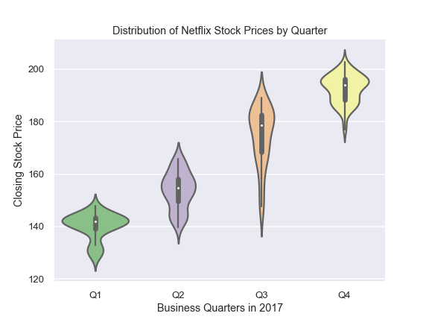
Netflix Stock Price Distribution

Slide 4
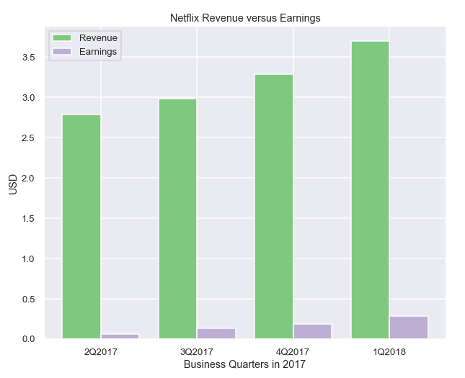
Netflix Stock And Revenue
Both the revenue and earning follow an increasing trend.
Earning of the company is roughly only 5% of the revenue, which we could assume the company spend most of its revenue on maintaining and improving the quality of the service they provide.

Slide 5
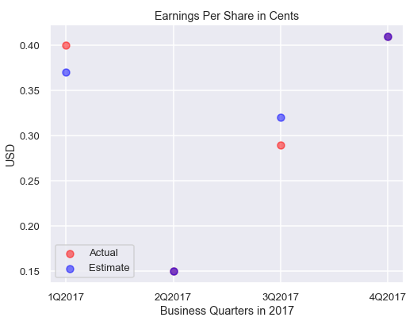
Netflix Earned Versus Actual Earning Per Share
For the first quarter, the actual EPS outperformed the estimated EPS while the actual EPS is lower that the estimated EPS during the third quarter.
The purple dots show that the actual EPS is equal to the estimated EPS.

Slide 6
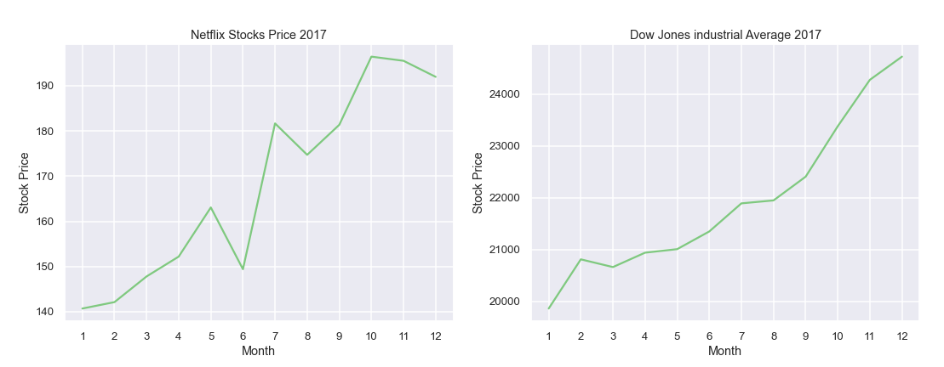
Netflix Stock Against Dow Jones Industrial Average

